Slide 1
Introduction to PolyBase
By Kevin Williams
kevin.williams@sdpstl.com (SDP)
Kupo.kev@gmail.com (Personal)
@KupoKev (Twitter)

Slide 2



Who am I? Kevin Williams
Business Intelligence Practice Lead at Software Design Partners
Worked in Business Intelligence for 5+ years
MCSE: Data Management and Analytics

Slide 3
Introduction to polybase
What Is PolyBase?
Setting Up PolyBase
Additional Resources
Using PolyBase (Demo)
Why Use PolyBase?

Slide 4
What is PolyBase?
Virtualizes external data
Allows SQL Server to process Transact-SQL queries against external data sources
Allows joining of tables across external data sources
Distributed query processing
Available on
SQL Server (On-Premise)
Azure Synapse Analytics
Parallel Data Warehouse

Slide 5
Brief History of PolyBase
Released SQL Server 2016 (Limited data sources)
Hadoop
Azure Blob Storage
Major update in SQL Server 2019 (Additional data sources)
SQL Server
Oracle
Teradata
MongoDB
ODBC

Slide 6
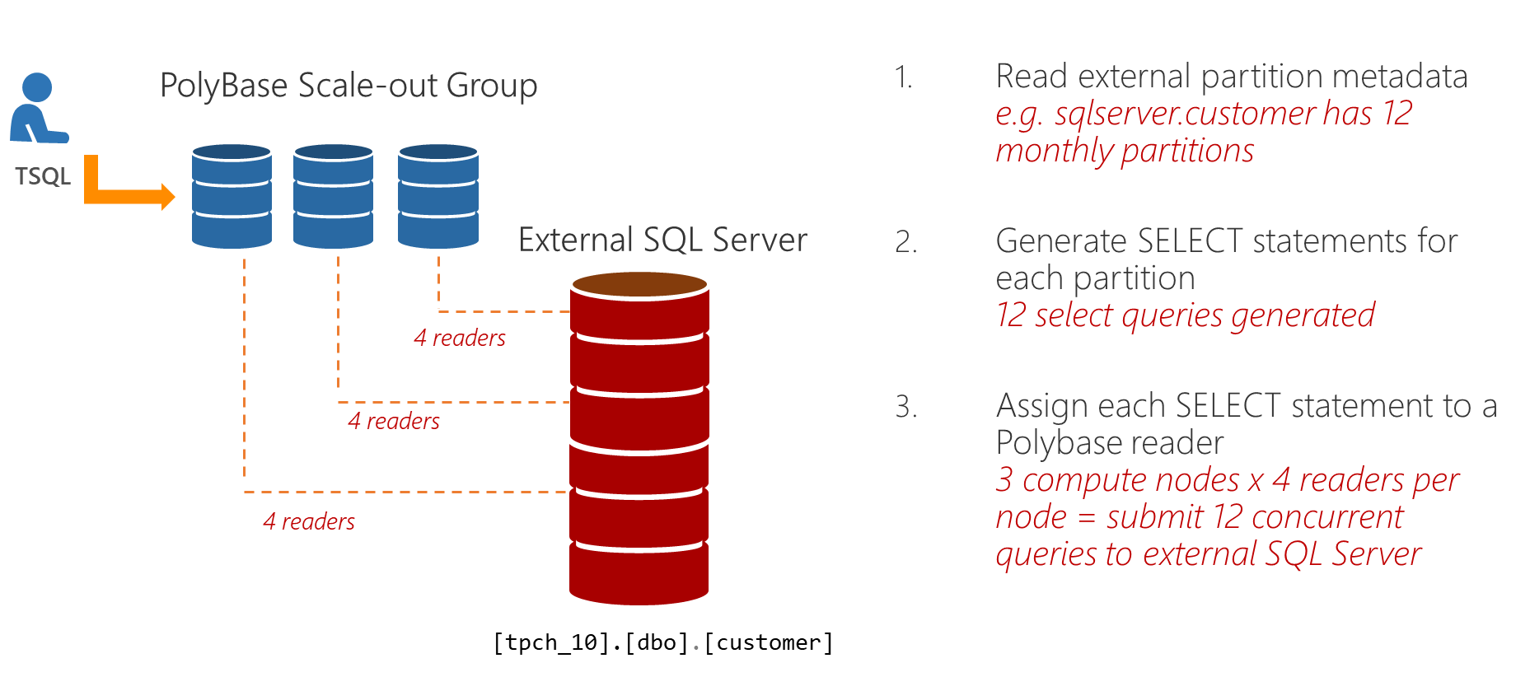
Note: Max 8 readers per node

Slide 7
Why use polybase?
ETL (Extract, Transform, Load)
Data virtualization reduces local storage needs
Data concurrency issues
Can use Integration Services to orchestrate scripts
Easy to connect to data source
SQL Server (On prem and in AWS)
CSV – ODBC
Progress – ODBC
SAP HANA

Slide 8
Setting up polybase
Available on SQL Server (Enterprise, standard), Azure Synapse Analytics, Parallel Data Warehouse
Can be installed on new or existing SQL Server instance
Need network connection to external data sources

Slide 9
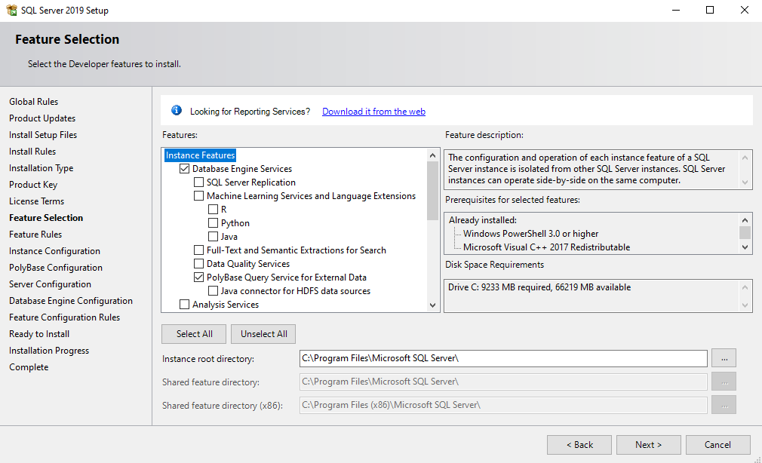
Setting up polybase: Installation
In SQL Server install, select the PolyBase feature
Select PolyBase install option in configuration screen
Standalone PolyBase-enabled Instance
PolyBase Scale-Out Group
Specify port ranges
Can only be installed once per machine

Slide 10
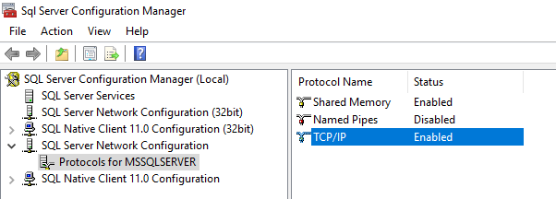
Setting up polybase: Post-Installation
Polybase Scale-out nodes must be run on same service account
In SQL Server Configuration, enable TCP/IP

Slide 11
Setting up polybase: Post-Installation
Make sure services are running
If services aren’t running, start services and restart SQL Server (May require reboot)
Enable firewall Rules for scale-out instances
Not necessary for standalone instance

Slide 12
Using Polybase
DEMO

Slide 13
Additional Resources
What is PolyBase?
https://docs.microsoft.com/en-us/sql/relational-databases/polybase/polybase-guide?view=sql-server-ver15
Design a PolyBase data loading strategy for dedicated SQL pool in Azure Synapse Analytics
https://docs.microsoft.com/en-us/azure/synapse-analytics/sql/load-data-overview

